Slide 1

What Can I Do
With a Ph.D
Alternative Career Paths
Life After UC Merced

Slide 2
Career Self Reliance
Forming Your Identity
“Success is Personal”-”Begins with Self-Assessment”
Your Values, Personal Attributes, Interests, Knowledge, Abilities, Skills, Experience, Challenges, Accomplishments
Personality, Career Beliefs, Family, Relationships, Gender,, Physical and Mental Health, Historical Trends, Age, Finances
Knowledge of the World of Work, Education, Global Needs
Knowledge of Resources Appropriate to You Personal, Academic and Career Developments Needs.
Chance/Happenstance
Notes:
However Defined, “Success is Personal- And Begins with Self-Assessment, Knowing yourself, which evolves through experence

Slide 3
Career Communities
Career Communities Organized by Career Fields & Industries
  Business and Entrepreneurship
  Engineering/Software Development/AI/Bio -Engineer/Materials Science/Chemical Engineering…….
  Help & Counseling, Health Careers
  Education
  Science
  Arts, Media & Entertainment
  Data & Information Technology/Data Scientist/Data Analyst
  Environment & Sustainability
  Law & Public Service/Community Service
  https://www.imaginephd.com/
What Work Environment & Job Tasks Interests Me

Slide 4
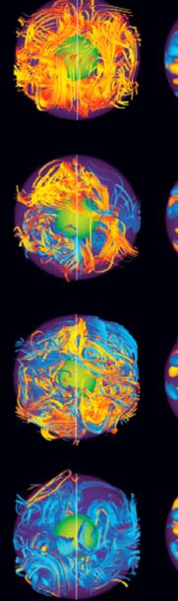
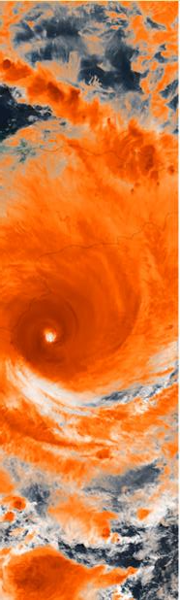
Career Self Assessment
Assessing Your Personality Skills
Creative
Outgoing
Visionary
Diplomatic
Energetic
Perceptive
Risk-Taker
Dependable
Communicative
Collaborative
Decisive
Resilient
Flexible
Resourceful
Reliable
Nurturing
Patient
Confident
Insightful

Slide 5

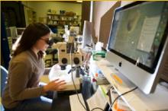
Career Self Assessment
Transferable Skill Sets
Analytical
  Analyze, Evaluate, Research, Observe, Manage Data,/Records, Problem Solve, Compute, Monitor, Categorize
Planning/Organizational
  Assess/Anticipate Needs, Analyze Data/Resources, Create Detailed/Progressive Plans, Organize Work Flows
Technical
  Program, Systems Administration, Create, Analyze, Build, Invent, Repair/Restore, Detailed Schematics, Mathematical, Logic, Mechanical Attributes
Notes:
1st Excercise

Slide 6


Career Self Assessment
Transferable Skill Sets
Leadership
  Create a Vision, Determine Policy, Make Command Decisions, Initiate, Negotiate, Supervise, Delegate, Mediate, Implement
Interpersonal
  Work Well with Others, Build Relationships, Patient, Counsel, Mediate, Nurture, Advocate
Creative
  Visualize, Design, Create Images, Compose, Conceptualize, Improvise, Perform, Invent, Produce, Brainstorm, Visionary
Communication
  Speak before Groups, Facilitate, Promote, Consult,
  Market, Train, Sell, Inspire, Write, Publish. Instruct
l

Slide 7

Additional
Career Resources
Career Self Assessment
Career decision-making is a process made more effective within a interactive, supportive group approach, identify how values, interests, preferences and satisfying skills relate to careers of interest
  Science Careers AAAS:
  http://sciencecareers.sciencemag.org/
Imagine Ph.D
https://www.imaginephd.com/

Slide 8


A Bit of Personal Advice
The universe sometimes throws you things, and I think you have to see it and be willing to jump. “Unplanned Happenstance” or as someone once said to me “Take Your Cookies When they’re Passed”
Never stop learning. You have to be open, and you have to listen, find what energizes you and keep learning.
Career Resilience: Change is Constant & Careers are Evolving as we Speak, Stay Knowledgeable, Be Prepared

Slide 9


Resources
http://hire.ucmerced.edu
https://ucmerced.joinhandshake.com/
Internships.com: Internships-USA (CEI Internships)
Associations, Print/Digital Magazines, Blogs, Papers

